Slide 1
Please select the ‘slideshow’ option and advance through the presentation manually

Slide 2
Top 10 in 2017

Slide 3
1: We changed our name…
Reflecting our new identity as a digital magazine for plant science news and stories
Published by the educational charity ‘Annals of Botany Company’
Since rebrand, numbers of visitors up over 50% - more eyes on your stories!
http://annalsofbotanycompany.co.uk/

Slide 4
2: Over 5,000 Twitter followers are keen to follow your articles…
https://twitter.com/botanyone

Slide 5
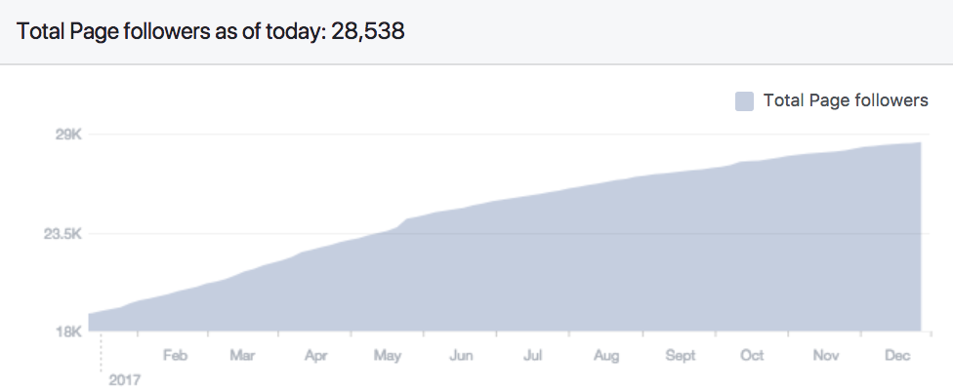
3: …and over 28,000 Facebook followers like your stories!

Slide 6
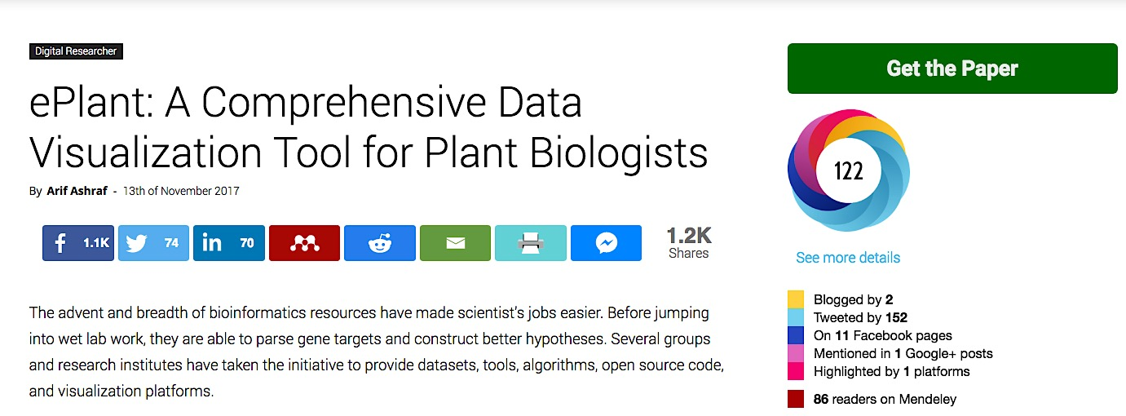
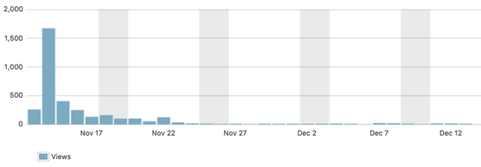
4: Our first story with over 1k shares was written by guest author Arif Ashraf

Slide 7
5: We’re still rated the Top Botany Blog on Feedspot
https://blog.feedspot.com/botany_blogs/

Slide 8
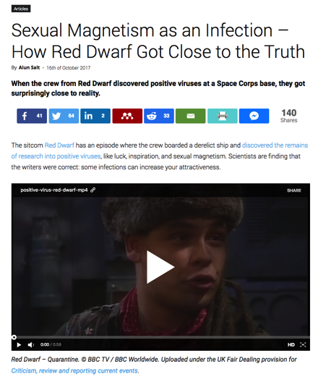
6: Our post linking plant science with the TV series ‘Red Dwarf’ gets retweeted…by the creator of Red Dwarf

Slide 9
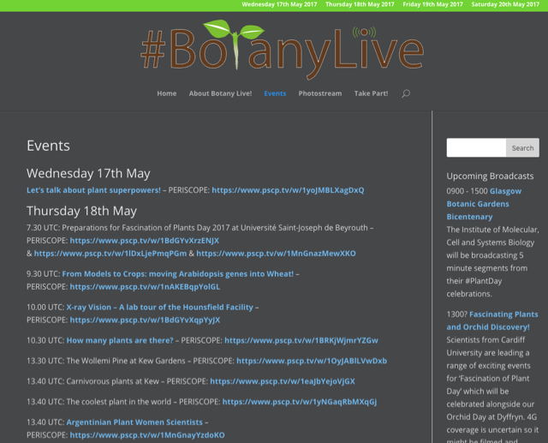
7: ‘Botany Live’ brought plant science from all over the world to our computers and devices
34 live-streams from all over the world
https://botany.live/

Slide 10
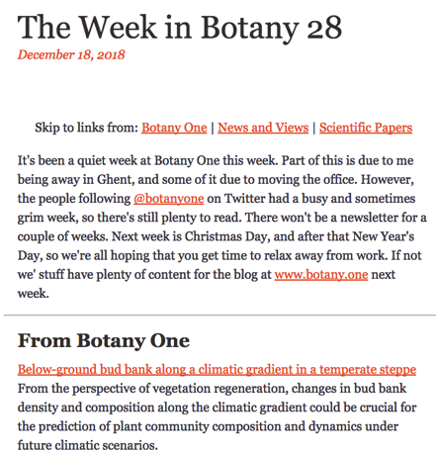
8: Your articles are now promoted with our new ‘The Week in Botany’ newsletter Subscribe here: http://www.botany.one/email/

Slide 11
9: Botany One is receiving books for review! Would you like to volunteer?

Slide 12
10: In 2017, we had a record number of guest contributors – you!
Laura Crook
Charlie Scutt
Emily Larson
Adam Cross
Maria Paniw
Fernando AO Silveira
Roberta LC Dayrell
Gail Taylor
Annabelle Damerum
Nikol Voutsina
Hazel Smith
Jeff Karron
Hugh Dickinson
Marcos Buckeridge
Aleksandra Rypień
José Gutiérrez
Gail Taylor
Nigel Chaffey
Joanne Ferrier
Pat Heslop-Harrison
Joseph Stinziano
Mike Jackson
Alexandra Boliver-Brown
Anna Jacob
Guillaume Lobet
Erin Sparks
Frédéric Bouché
Jenna Loiseau
Jack Bailey-Bale
Dorota Kwiatkowska
Rod Hunt
Zoe Popper
Tjelvar Olsson
Megan Lynch
Sarah Cody
Bill Hammond
Arif Ashraf

Slide 13
Working with you has been our highlight this year! Thank you for writing us in 2017, and we hope to ‘see’ you again in 2018. ☺ The Botany One team Anne Osterrieder, Alun Salt and Ian Street

